Slide 1
Secure Data Hiding in Image Using Steganography
CAPSTONE PROJECT
Presented By: YASHIKA SHARMA
Student Name : YASHIKA SHARMA
College Name & Department :
Maharaja Agrasen Institute Of Technology,Delhi,ITE Department

Slide 2
OUTLINE
Problem Statement
Technology used
Wow factor
End users
Result
Conclusion
Git-hub Link
Future scope

Slide 3
Problem Statement
Designing a secure steganographic method for hiding data in images remains challenging due to trade-offs between capacity, imperceptibility, and resistance to attacks. Existing techniques often distort image quality or leave detectable traces, making hidden data vulnerable. The goal is to ensure covert, high-capacity data embedding resistant to steganalysis.

Slide 4
Technology used
Programming Languages – Python,IDLE 3.13.64bit
Vs code
Libraries used: CV2,string,operating system
Platform used: WINDOWS
Processor: AMD Ryzen 5 5600H with Radeon Graphics 3.30 GHz
Installed RAM: 8.00 GB (7.34 GB usable)
System type: 64-bit operating system, x64-based processor

Slide 5
Wow factors
Real-Time Encoding & Decoding – Develop a user-friendly tool that allows instant embedding and extraction of hidden messages.
Dynamic Payload Optimization – Implement an adaptive algorithm that adjusts embedding based on image characteristics for maximum capacity with minimal distortion.

Slide 6
End users
Government & Defense Agencies – For covert communication and secure intelligence transmission.
Cybersecurity Professionals – To enhance data protection and prevent unauthorized access.
Journalists & Whistleblowers – To safely transmit sensitive information without detection.
Corporate & Financial Institutions – For securing confidential business and financial data.
Healthcare Sector – To protect patient records and medical data while complying with privacy regulations.
General Users & Privacy Enthusiasts – For personal data security and private communication.

Slide 7
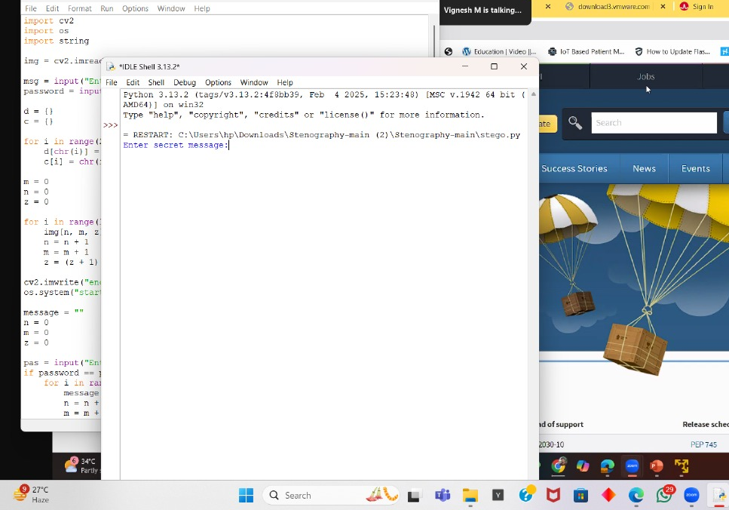
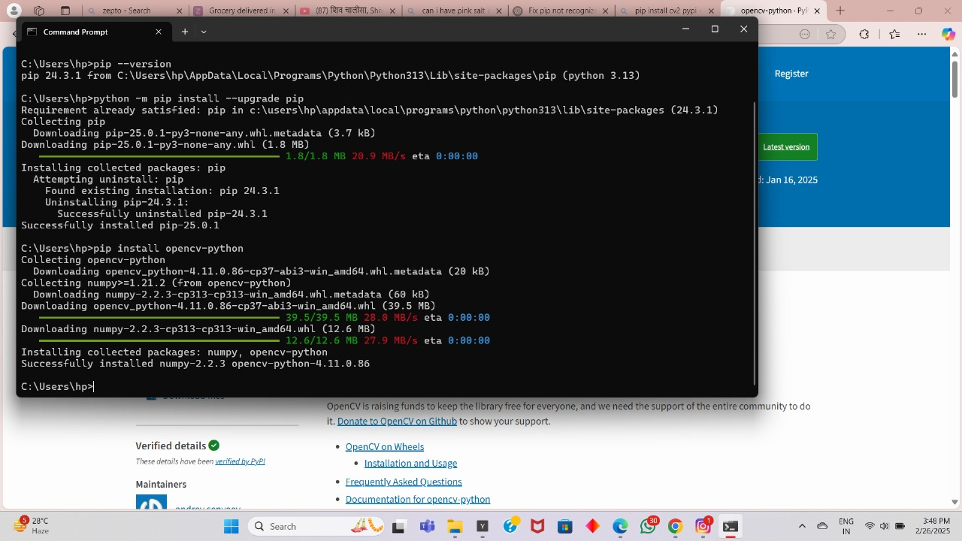
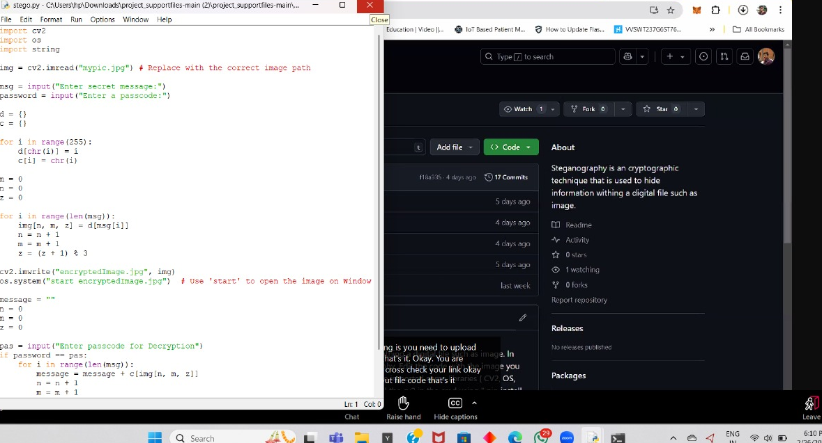
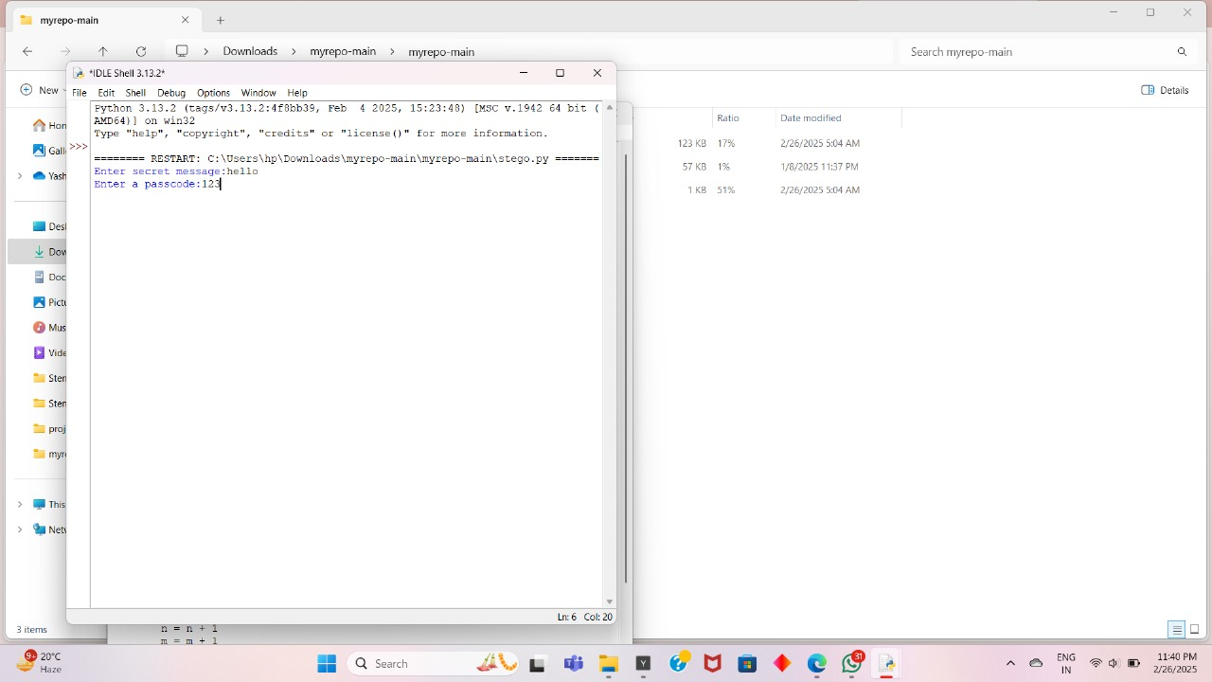
Results

Slide 8
Conclusion
The results demonstrate that the implemented solution achieves high embedding capacity while maintaining image quality and security. This work contributes to secure digital communication, providing a reliable method for covert data transmission across various applications, including government, corporate, and personal privacy protection. Future improvements could involve AI-driven techniques to further enhance security and adaptability.
By integrating cryptographic techniques with optimized embedding methods, the proposed approach ensures that sensitive data remains hidden and protected from unauthorized access or detection.

Slide 9
GitHub Link
https://github.com/yashikaaasharma/aicte-project-cybersecurity.git
Readme.md:
need run python 3
lib
pip install cv2

Slide 10
Future scope(optional)
Cross-Media Steganography – Expanding beyond images to videos, audio, and 3D models, allowing seamless covert communication across multiple formats.
Steganography in IoT & Cloud Security – Enhancing IoT device communication and cloud storage encryption with hidden data techniques for secure remote access.

Slide 11
THANK YOU

